Slide 1
EVOLUTIONARY COMPUTING AND QUANTUM OPTIMISATION INITIATED MRI IMAGE BASED ALZHEIMER’S DETECTION
ARSHIYA ZAKIR HUSSAIN
REG NO: 209302196
B-TECH IT 6C
Under the Guidance of
Mr. Venkatesh Gauri Shankar

Slide 2
Introduction
Alzheimer's is a serious neurological disorder whose early diagnosis is difficult. The main work mostly is to do an accurate classification of patients with Alzheimer's and the patients who are healthy. This also has to do with feature selection, As some of the features might be irrelevant or redundant. On the other hand, using all the Features might reduce the effectiveness of the classification. Studies show machine Learning models and neural networks show phenomenal potential in making the task at Hand effective and accurate.
The aim is to reduce processing time and improve the performance of the solutions and For the same improved genetic algorithms would be introduced depending on different Natural processes. the algorithms will be defined as optimized if they cover three out of Many factors considered for optimization ability i.e. being simple in concept, easy to Implement, and computationally efficient.
The outline of the work sketches working with ADNI datasets that include MRI images of the Brain and then selecting and developing machine learning models that can perform the Underlined task of early detection. The quantum optimization techniques would be Applied to the developed model for optimized results and enhanced functioning.

Slide 3
RELATED WORK
S.no | Study | Approach
1. | An eight-layer CNN structure was studied by Wang et al. Six layers served the feature extraction process in convolutional layers and two fully connected layers in classification. The results showed that max-pooling and Leaky Rectified Linear unit gave a high performance. | Deep Learning
2. | Korolev et al. proved that an equivalent performance could be realized. When the residual network and plain 3D CNN architectures were applied on 3D structural MRI brain scans, the results showed that the two networks’ depth was very long, and the complexity was high. They did not achieve high performance as expected. | Deep Learning
3. | A novel CNN framework was proposed based on a multi-modal MRI analytical method using DTI or Functional Magnetic Resonance Imaging (fMRI) data by Wang et al. The framework classified AD, NC, and amnestic mild cognitive impairment (aMCI) patients. Although it achieved high classification accuracy, it is expected that using 3D convolution instead of 2D convolution would give better performance. | Deep Learning
4. | "Quantum-inspired binary immune algorithm for feature selection and classification of Alzheimer's disease" by Md. Rakibul Islam and Md. Ahsan Ullah. | Quantum-inspired algorithm and feature selection

Slide 4
PROBLEM- STATEMENT
Alzheimer’s illness is a retrogressive sickness which is irremediable. It effects the limbic framework And its most significant capacities are the consolidation of data from momentary memory to long haul Memory . As the ailment advances, every single influenced zone of the cerebrum start to shrink. Alzheimer whenever analyzed early can encourage opportune access to analysis and medical Services.
The problem in this field is that:
Early detection is not easy if suitable tools and method and are not available
Although now deep learning and machine learning have made it far more easier to detect the Disease at early stage, the models applied are not accurate or fast enough to do the job in given Time framework and with good accuracy, which is by far the most important factor in medical field
Image quality is often compromised because of the noise and improper preprocessing

Slide 5
OBJECTIVES
To detect Alzheimer's using evolutionary computing and quantum optimization
Classify MRI images into ‘AD’ (Alzheimer disease) and ‘CN’(normal cognitive)
Using multiple models of CNN that are U-Net, VGG16,VGG19,DENSE-Net to compare the Results and apply quantum optimization methods and evolutionary computing concepts to Improve the results and enhance the performance of the models
To evaluate the performance of the developed system using real-world datasets such as the Alzheimer's Disease Neuroimaging Initiative (ADNI) dataset, giving more test data and Accordingly learning and improving feature selection to reach top notch accuracy

Slide 6
NOVELTY OF THE WORK
Using concepts of evolutionary computing and quantum optimization to improve the calculated results of The different CNN models so as to get more and more apt results eliminating the chances of small errors Which could result in big miscalculations
Genetic algorithms identify the most meaningful features with the minimum set of features, which may Be relevant for automated assessment of brain FDG-PET images.
Associated with Alzheimer's disease. The input to the genetic algorithm is a set of measures obtained by Merging various biological evidence types into a complex network, based on a set of genes already Known to be associated with this disease.
A multi-objective genetic algorithm is applied to the problem of identifying genes
The overall ranking of the genes across all runs is examined and suggests some genes worthy of further Study with respect to their link to this disease
Based on these conclusions apt feature selection is done for better accuracy.

Slide 7
PROPOSED METHODOLOGY
Data Selection:
Selecting MRI data from ADNI
Preprocessing data using image enhancement techniques:
Image enhancement
Image registration
Skull stripping
Skull masking
c) Cleaning data
d) Scaling data
Model Selection and Implementation:
CNN:
U-Net -> TRAINING + SEGMENTATION
VGG-16 -> USES 16 HIDDEN LAYERS TO FORM DENSE N/W
DENSE-Net
Optimization:
Optimizing the results using evolutionary computing and quantum optimization

Slide 8
PROPOSED METHODOLOGY
EXECUTION:
DATA SELECTION:
Data was selected from ADNI which was downloaded in the form of nii files
The first step was to convert the nii data into png format
DATA PREPROCESSING:
Firstly Data was visualized
Image enhancement was used to eliminate all the noise and highlight the skull region for better Training
Enhancements used:
Grey scaling
Median filtering
Histogram equalization
Laplacian filtering for enhancing edges

Slide 9
PROPOSED METHODOLOGY
MODEL SELECTION:
Using CNN models for training
U-Net model along with training, segments the images as well
VGG-16/VGG-19 forms a dense network of 16-19 hidden layers(not used yet)
DENSE-NET(not used yet)
These models are apt for medical image data handling and hence selected
MODEL IMPLEMENTATION:
Data is split into training and testing and then all the above models are applied
Evaluation is done using testing data
Data prediction is done based on the test data set
Finally results from all the models is analyzed and further optimization techniques are Applied
OPTIMISATION TECHNIQUES:
Using evolutionary computing and quantum optimization(work in progress)

Slide 10
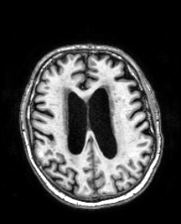
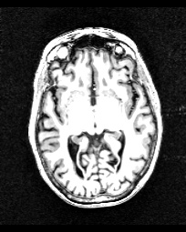
RESULTS
AD(ALZHEIMER DISEASE)
CN(NORMAL COGNITIVE)

Slide 11
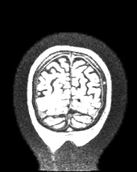
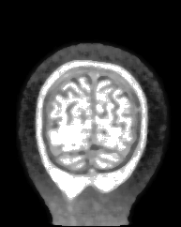
RESULTS
ORIGINAL IMAGE VS ENHANCED MRI IMAGE:
ORIGINAL IMG
ENHANCED IMG

Slide 12
RESULTS
MODEL TRAINING RESULTS[U-Net]
U-Net is a ‘U’ shaped architecture model which is used for semantic segmentation of Images along with data training. The architecture is symmetric and consist of contracting Path, which is constituted by general convolution process and the right part is the Expansive path, which is constituted by transposed 2d convolution layers.
The contracting phase:
Conv_layer1 -> conv_layer2 -> max-pooling -> dropout(optional) [repeated 3 times]
Here image dimensions contract say from 572*572*1 -> 568*568*64
The expansive phase:
Conv_2d_transpose -> concatenate -> conv_layer1 -> conv_layer2
Here image dimension expand say from 56*56*512 -> 56*56*1024

Slide 13
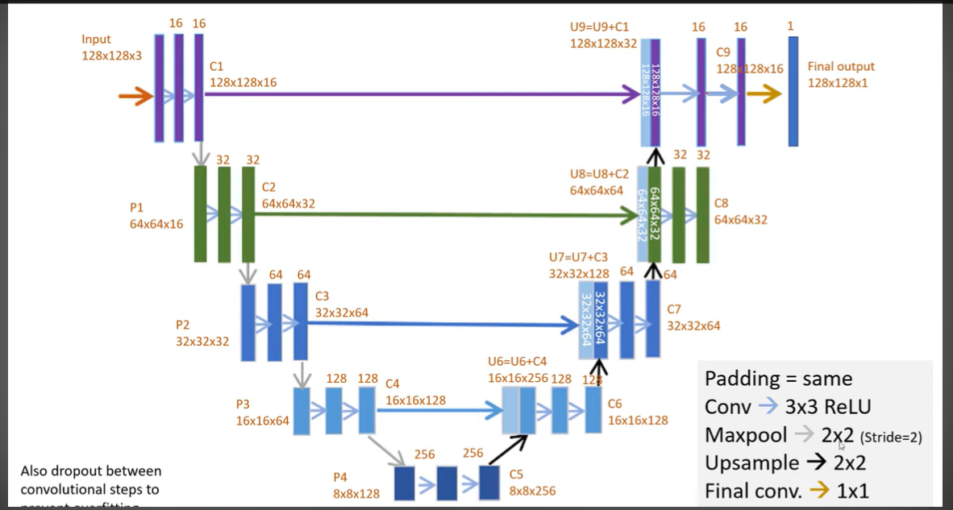
RESULTS
U-Net ARCHITECTURE
WITH RHS -> CONTRACTION(DOWNSAMPLING) LHS->EXPANSION(UPSAMPLING)

Slide 14
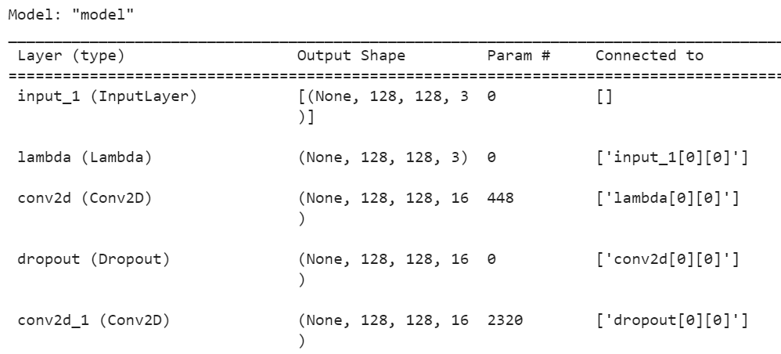
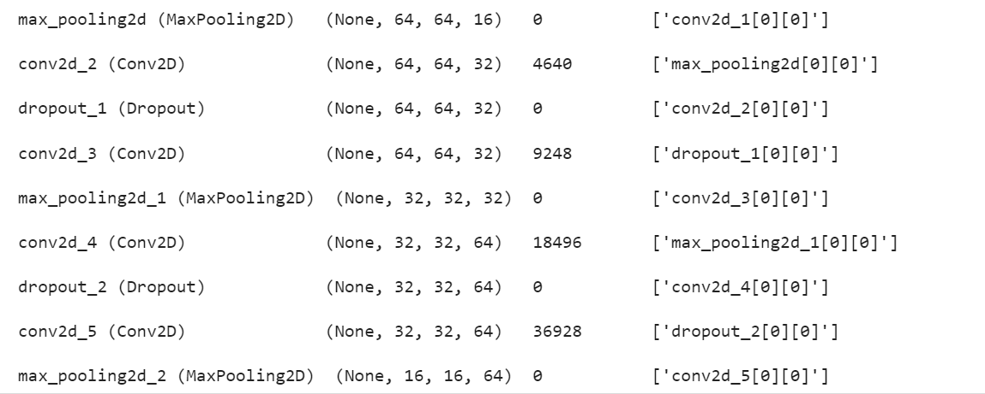
RESULTS
MODEL SUMMARY

Slide 15
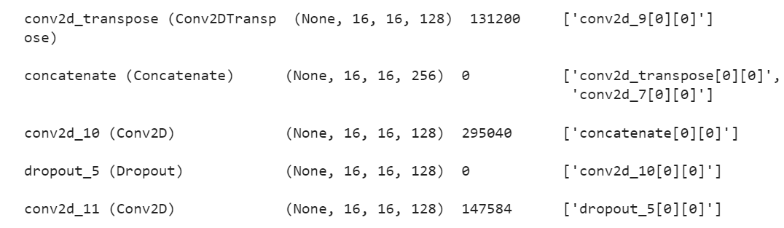
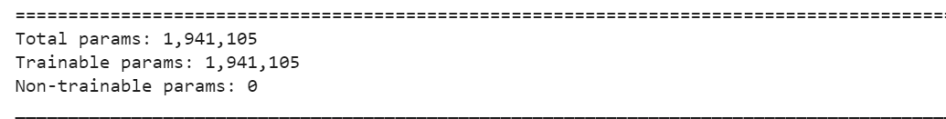
RESULTS

Slide 16
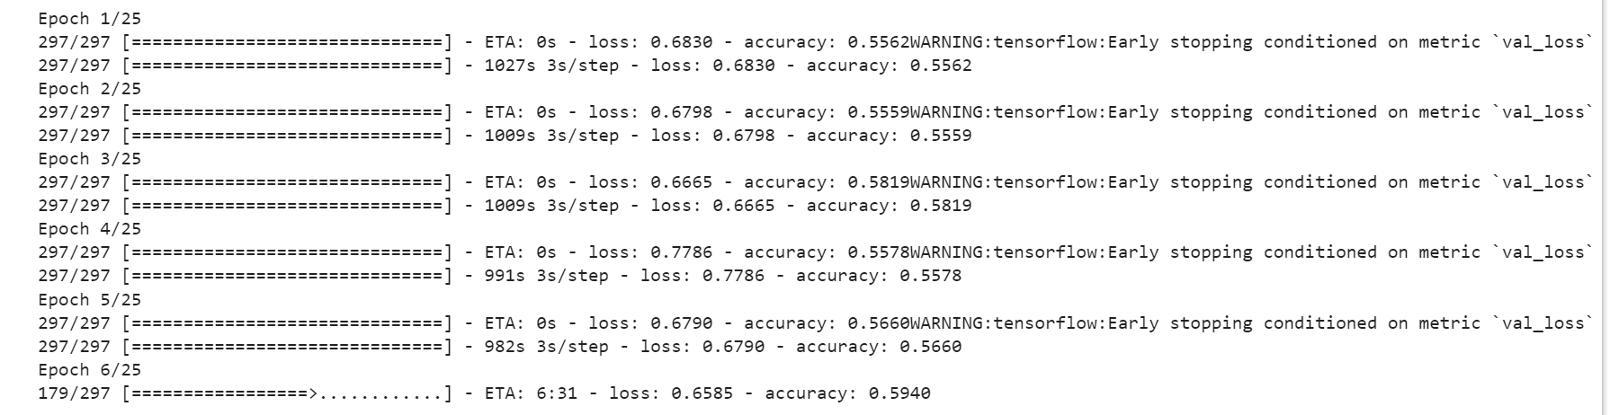
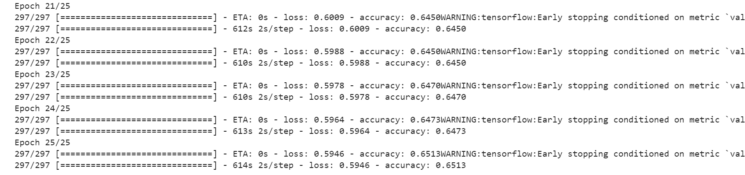
RESULTS
U-Net results:

Slide 17
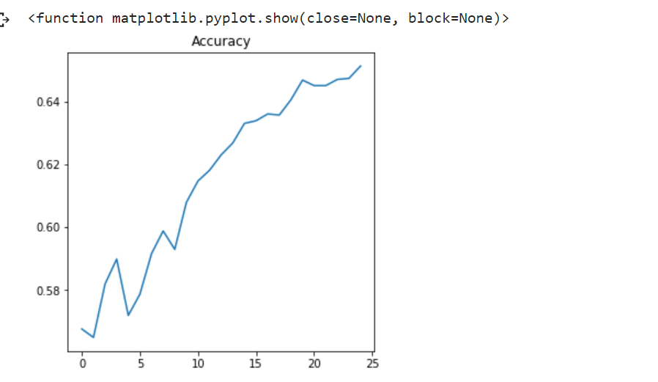
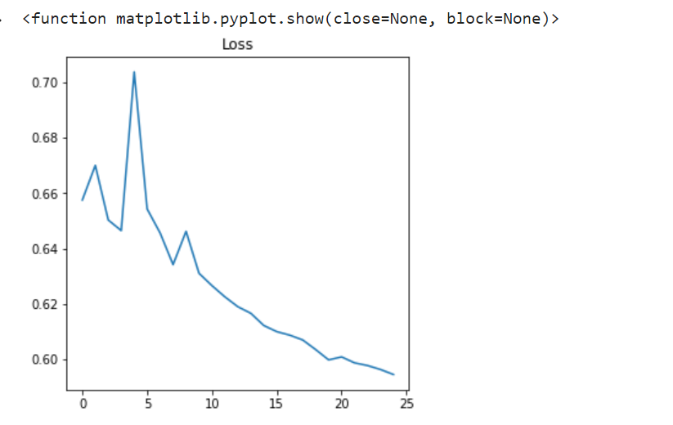
RESULTS
RESULT VISUALISATION:
ACCURACY GRAPH
TRAINING ACCURACY
LOSS GRAPH
TRAINING LOSS
X-AXIS:EPOCH, Y-AXIS:ACCURACY
X-AXIS: EPOCH, Y-AXIS:LOSS

Slide 18
Work after mid-term

Slide 19
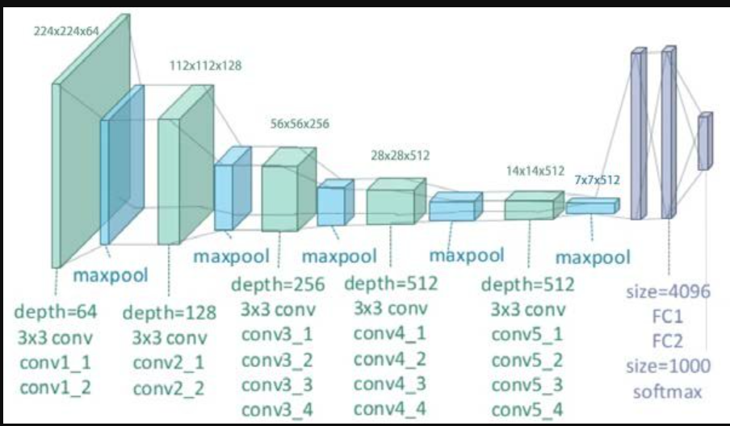
RESULTS:VGG-19
ARCHITECTURE

Slide 20
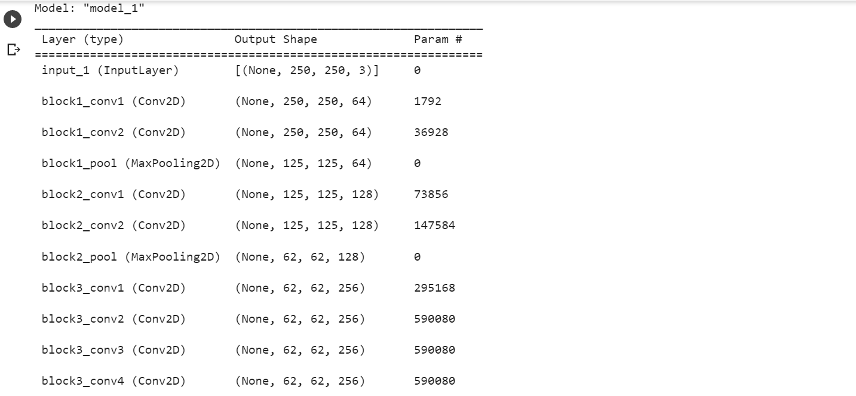
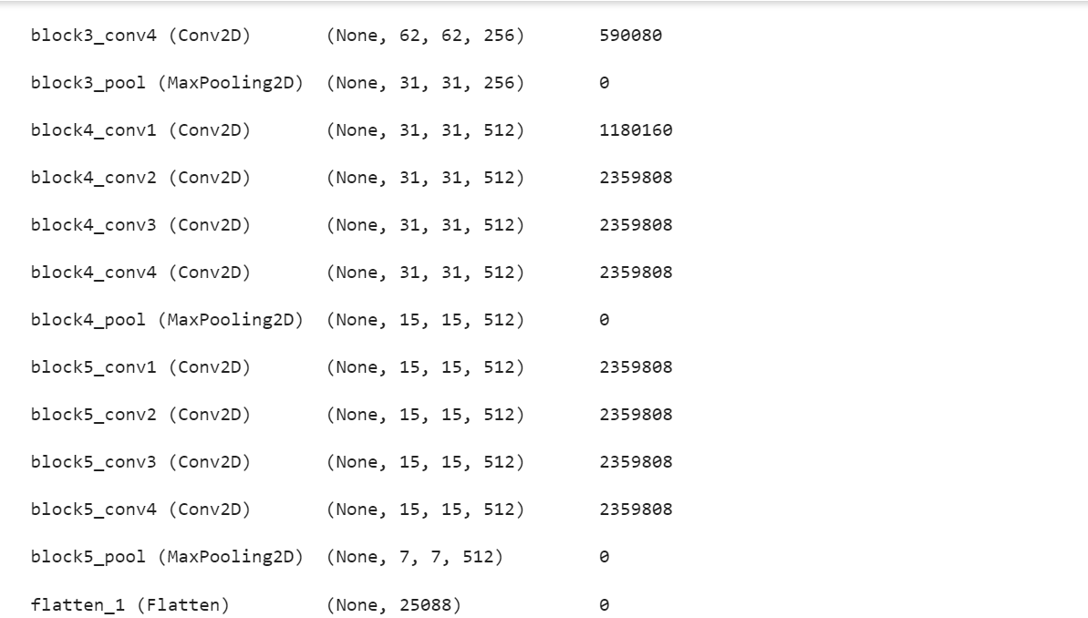
RESULTS

Slide 21
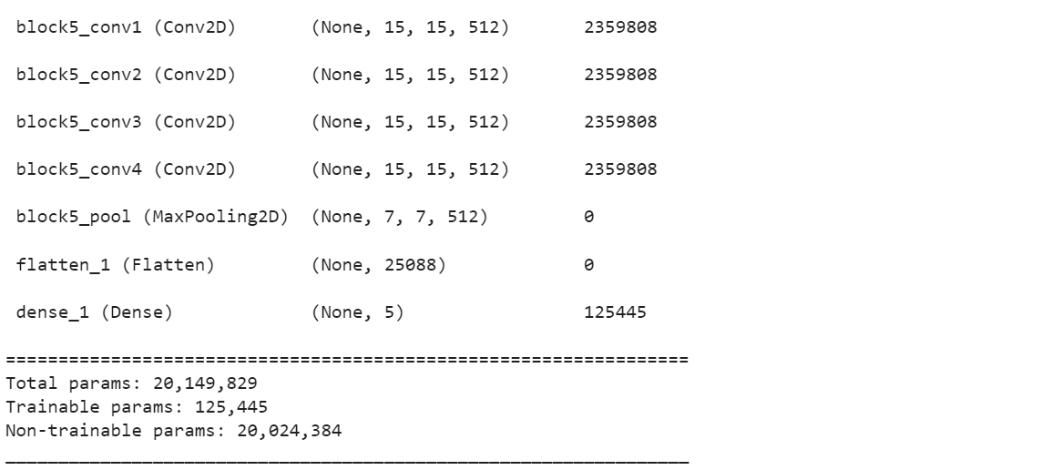
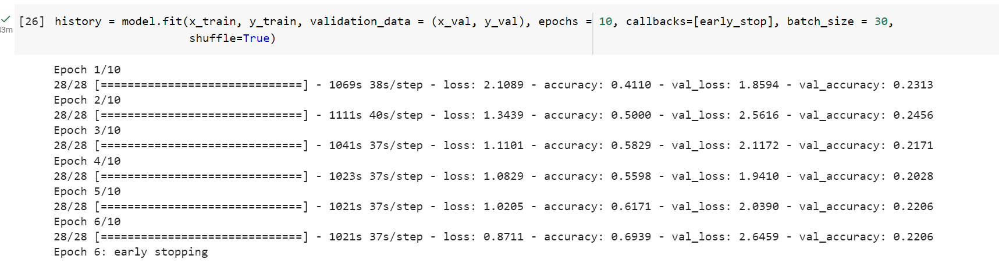
RESULTS

Slide 22
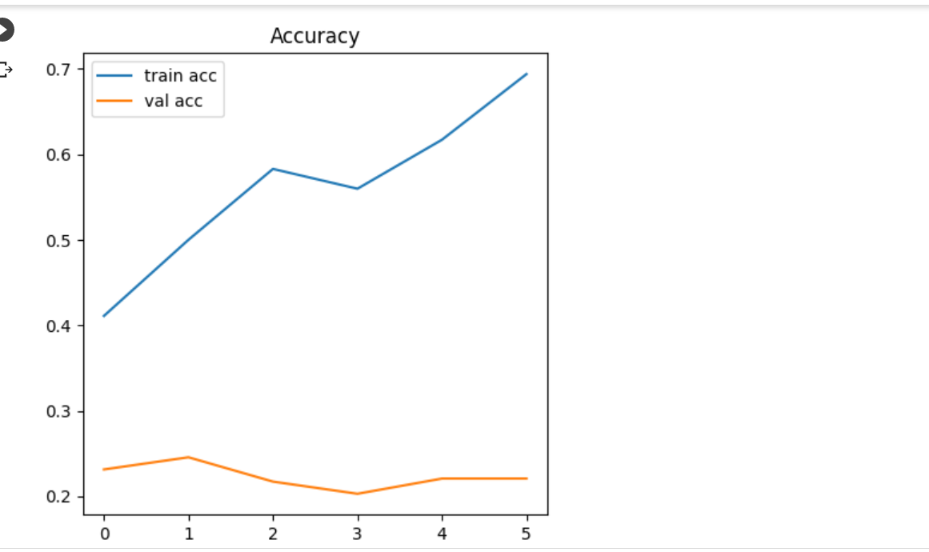
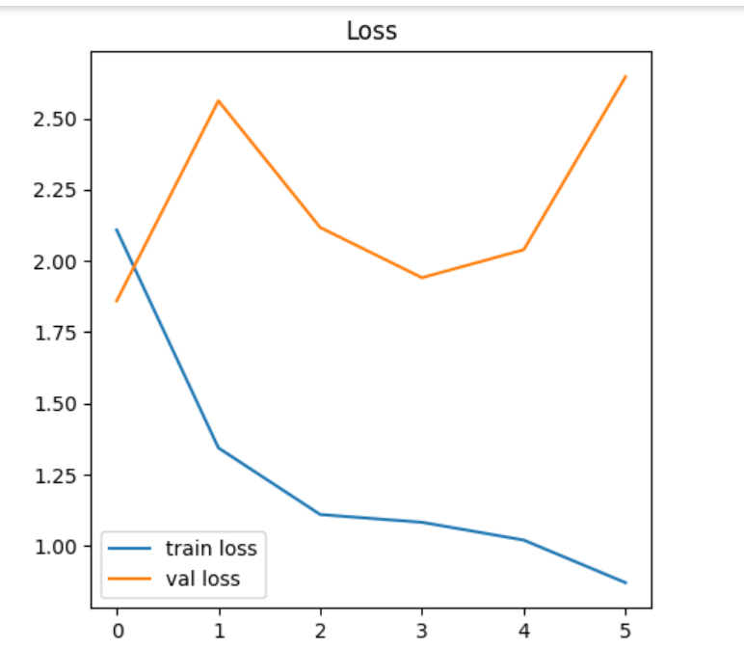
RESULTS
Training and validation accuracy
Training and validation loss
X-AXIS: EPOCHS
Y-AXIS:ACCURACY IN %
X-AXIS:EPOCHS
Y-AXIS:LOSS IN %

Slide 23
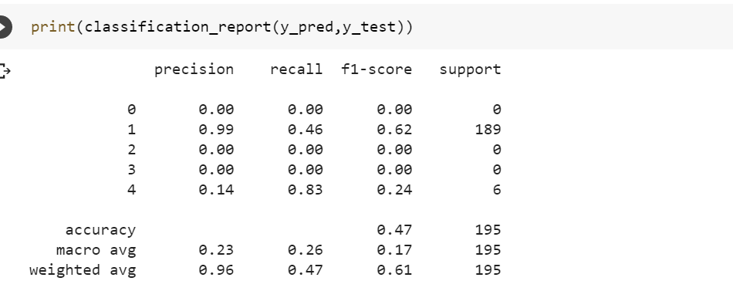
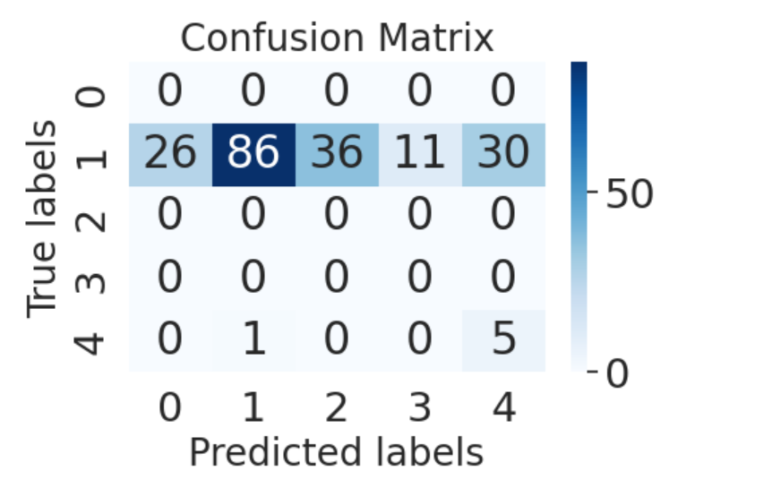
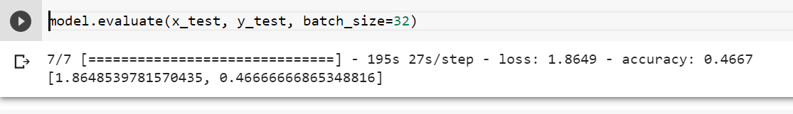
RESULTS
Classification report and evaluation
Confusion matrix

Slide 24
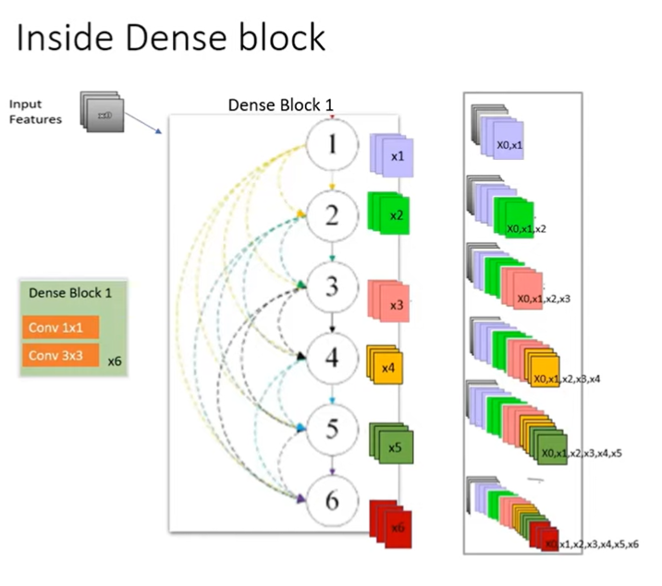
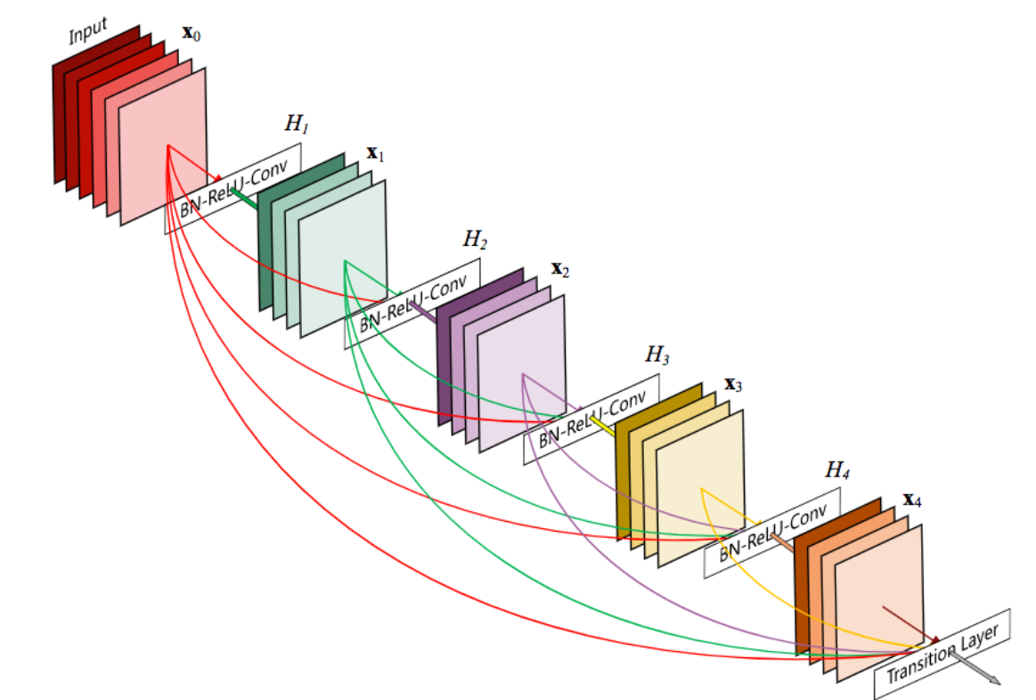
RESULTS: DENSE-NET
ARCHITECTURE

Slide 25
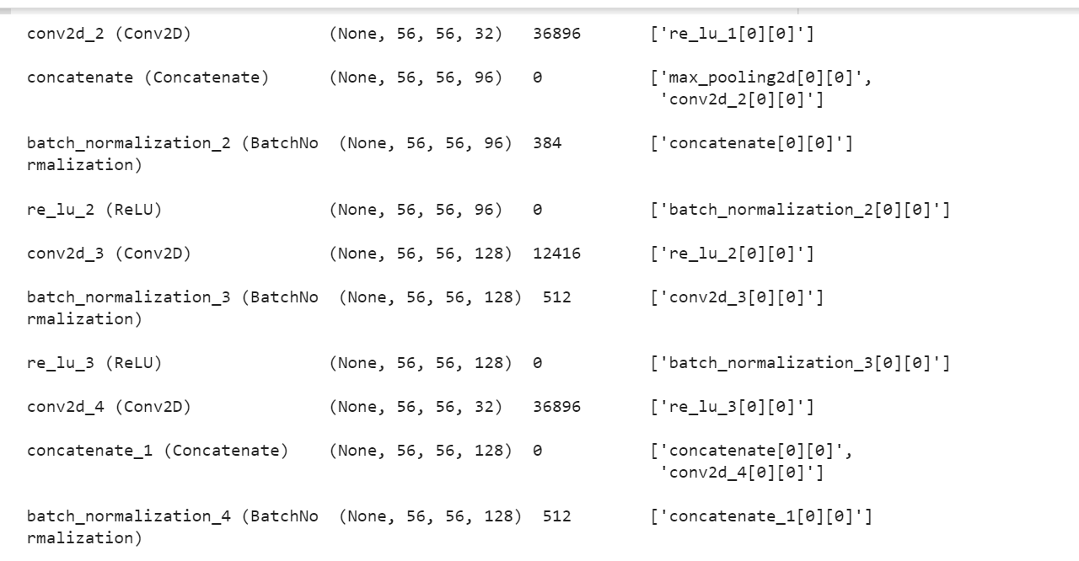
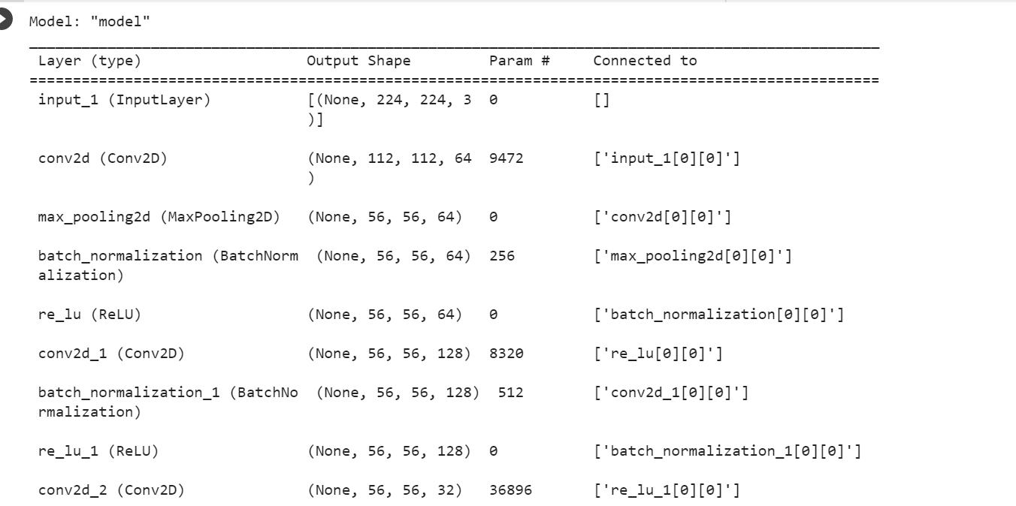
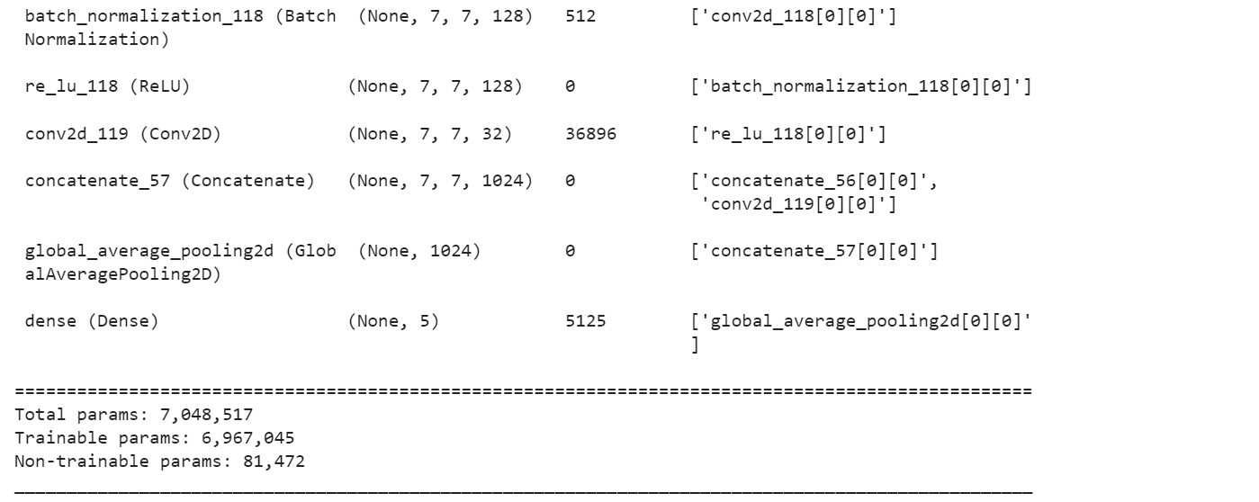
RESULTS
MODEL SUMMARY

Slide 26
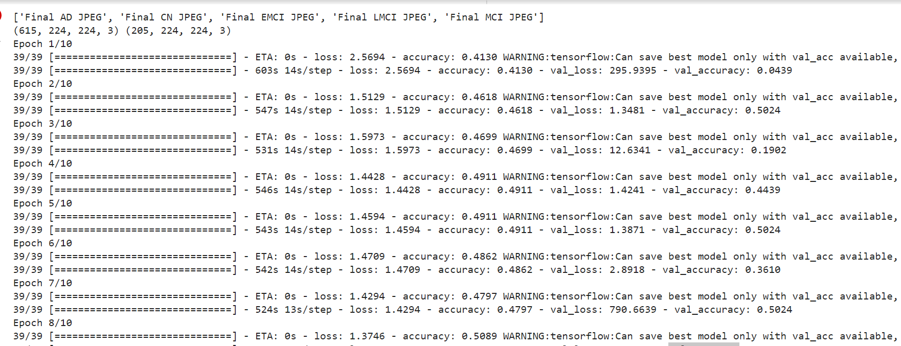
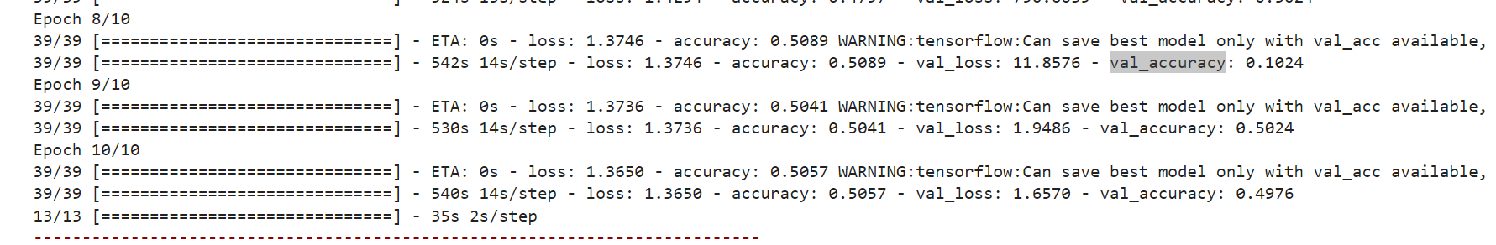
RESULTS
EPOCHS:

Slide 27
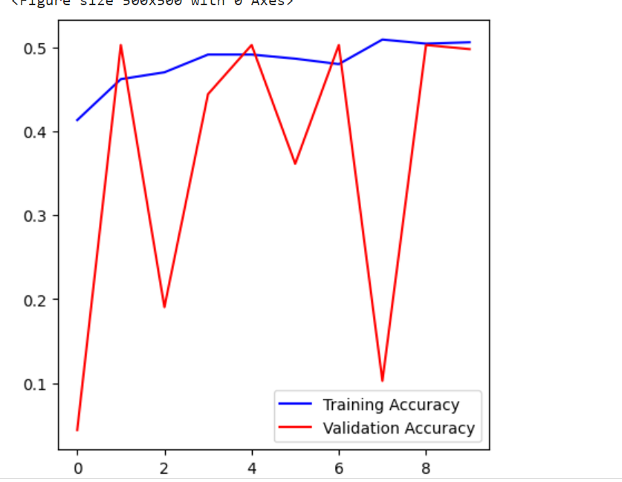
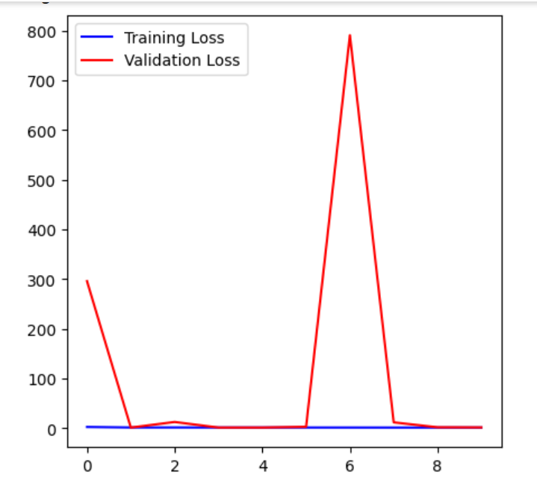
RESULTS
TRAINING AND VALIDATION ACCURACY
TRAINING AND VALIDATION LOSS
X-AXIS: EPOCH,
Y-AXIS: ACUCURACY
XX-AXIS: EPOCH, Y-AXIS:LOSS

Slide 28
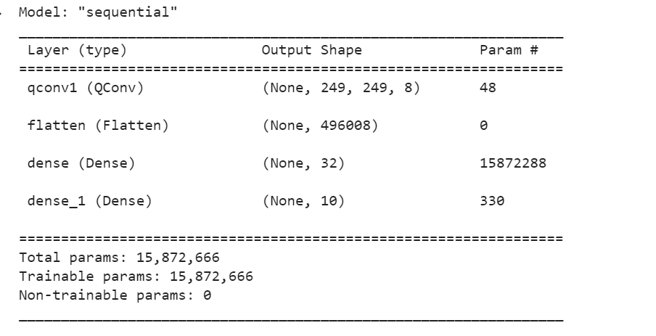
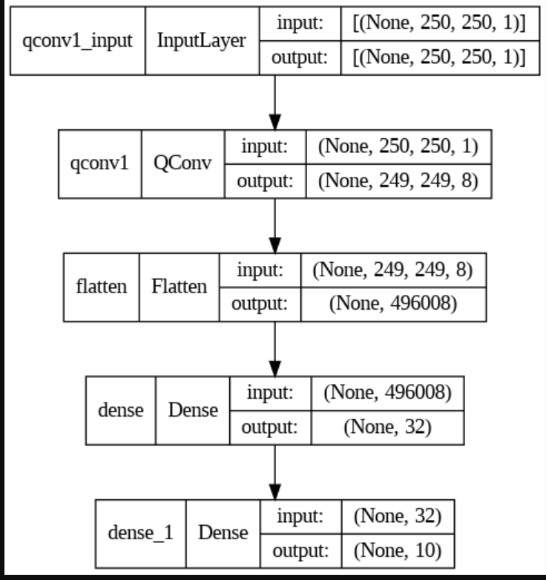
RESULTS
QCNN MODEL SUMMARY AND ARCHITECTURE

Slide 29
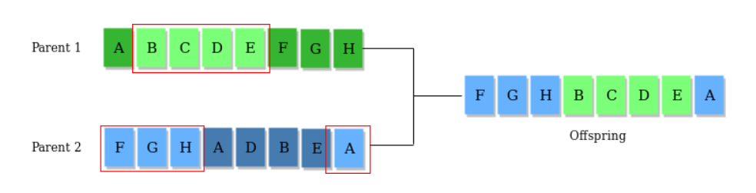
Genetic Algorithms
Genetic Algorithms(GAs) are adaptive heuristic search algorithms that belong to the larger part of evolutionary algorithms. Genetic algorithms are based on the ideas of natural selection and genetics. These are intelligent exploitation of random search provided with historical data to direct the search into the region of better performance in solution space. They are commonly used to generate high-quality solutions for optimization problems and search problems.
Search space
The population of individuals are maintained within search space. Each individual represents a solution in search space for given problem. Each individual is coded as a finite length vector (analogous to chromosome) of components. These variable components are analogous to Genes. Thus a chromosome (individual) is composed of several genes (variable components). A Fitness Score is given to each individual which shows the ability of an individual to “compete”. The individual having optimal fitness score (or near optimal) are sought.

Slide 30
WORK STATUS
Completed with Data preprocessing
Model selection and implementation done
Data split in training and testing done
U-Net Model applied, VGG-19, DENSE-NET done
Evaluation and Prediction done
Optimization phase still in work
Have to Implement genetic algorithms, quantum inspired particle swarm model, neuro quantum optimization model
For quantum optimization, have tried applying
QCNN model but could not implement due to some errors

Slide 31
CONCLUSION
The U-Net model could only give an accuracy of 65%
There could be many reasons for this some assumed:
Data preprocessing could have been more effective for better accuracy
Data rescaling if not done properly could give bad results so overall for a model to Perform better it is required to have an efficient data preprocessing
Data splitting not done properly as input data is pixel value matrix and class labeled data that will be the output is categorical so converting it into binary and then matching with the dimensions of input image matrix could have been miscalculated
Improvement:
Better data processing
Applying other models to analyze and choose the one with relatively better accuracy then All other

Slide 32
RESEARCH PAPER
Evolutionary Computing and Quantum Optimization initiated MRI image-based Alzheimer’s detection
INITIAL WRITING STARTED

Slide 33
REFERNCES
Josefa Diaz Alvarez, Jordi A. Matias Guiu, Maria Nieves Cabrera Martin, Vanesa Pytel, Ignacio Segovia-Rios, “Genetic Algorithms for Optimized Diagnosis of Alzheimer’s Disease and Frontotemporal Dementia Using Fluorodeoxyglucose Positron Emission Tomography Imaging, front. Aging neurosci.”, 03 February 2022
Guangyao Chen, James Sargant, Sheridan Houghten, Tyler K. Collins, “Identification of Genes Associated with Alzheimer’s Disease using Evolutionary Computation”, 18th oct 2021, IEEE
Nikola Kasabov, Reinhard Schleibs, Hiroshi Kojima, “Probabilistic Computational Neurogenetic Modelling: from Cognitive Systems to Alzheimer’s Disease”,20th June,2011
Hadeer A. Helay, Mahmoud Badawy, Amira Y.Haikal, “Deep Learning approach for early Detection of Alzheimer’s Disease”, 03 Nov.2021

Slide 34
Thank you

